Slide 1
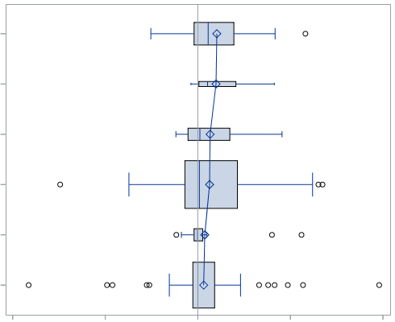
IC
Milk
Peanut butter
Toilet Tissue
Yogurt
Sugar substitutes
Shampoo
-0.5
-0.25
0
0.25
0.5

Slide 2
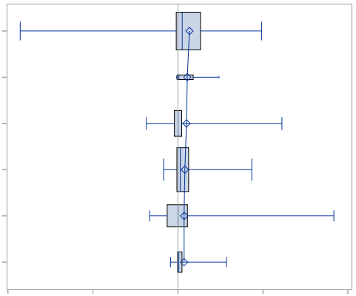
EWC
Spaghetti Sauce
Face Tissue
Toothpaste
Yogurt
Toilet Tissue
Household Cleaner
-0.4
-0.2
0
0.2
0.4

Slide 3
Milk
Spaghetti Sauce
Peanut butter
Face Tissue
Toothpaste
Toilet Tissue
Yogurt
Yogurt
Sugar substitutes
Toilet Tissue
Shampoo
Household Cleaner
-0.5
-0.25
0
0.25
0.5
-0.4
-0.2
0
0.2
0.4

Slide 4
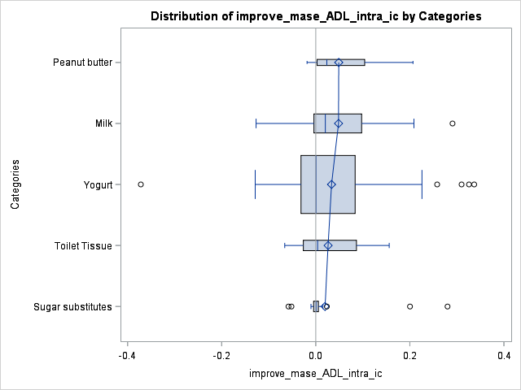
IC
Peanut butter
Milk
Yogurt
Toilet Tissue
Sugar substitutes
-0.4
-0.2
0
0.2
0.4

